Slide 1
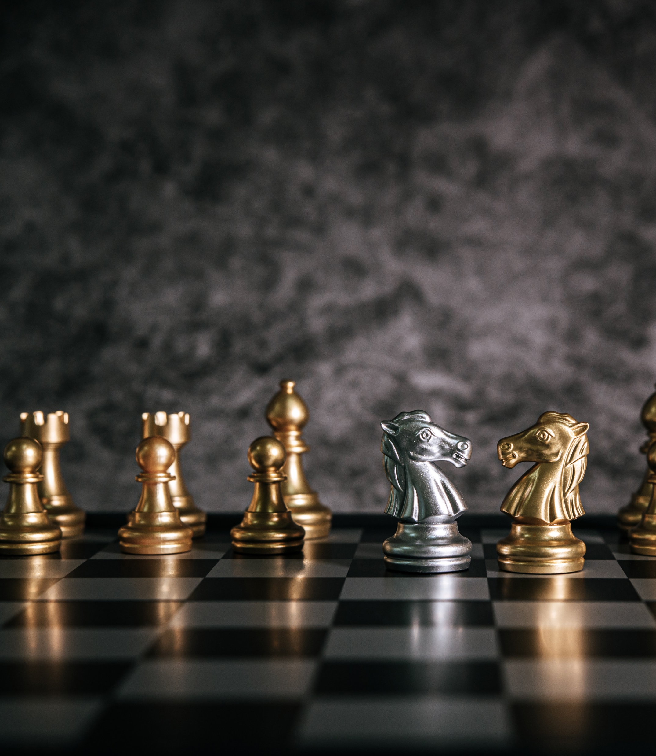

CHESS AI
TEAM NO : 15
AADHARSH R - 2019103604
BHUVANESHWAR S - 2019103513
DHEEPAK RAAJ - 2019103516
PARUSU SUNNY - 2019103602

Slide 2
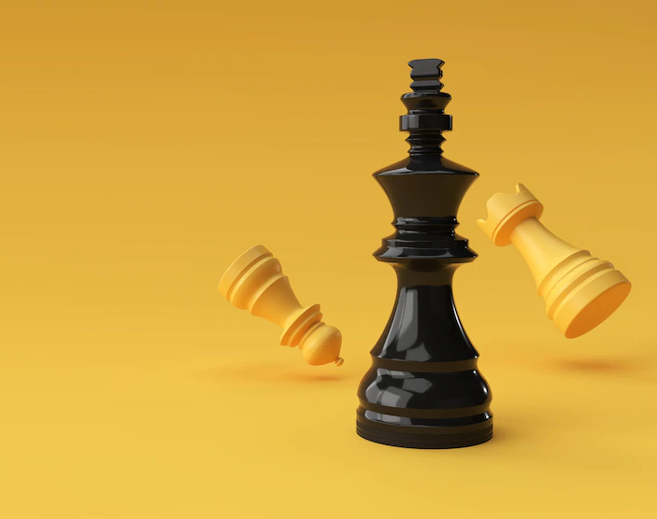
CONTENT

Slide 3

SNO | CONTENT | PAGE NO
1 | INTRODUCTION | 4
2 | LITERATURE SURVEY | 6
3 | PROBLEM STATEMENT | 10
4 | OBJECTIVE | 12
4 | SYSTEM ARCHITECTURE | 14
5 | LIST OF MODULE | 16
6 | EXPLANATION OF MODULE | 18
7 | EVALUATION MATRIX | 27
8 | REFERENCES | 29

Slide 4
INTRODUCTION

Slide 5
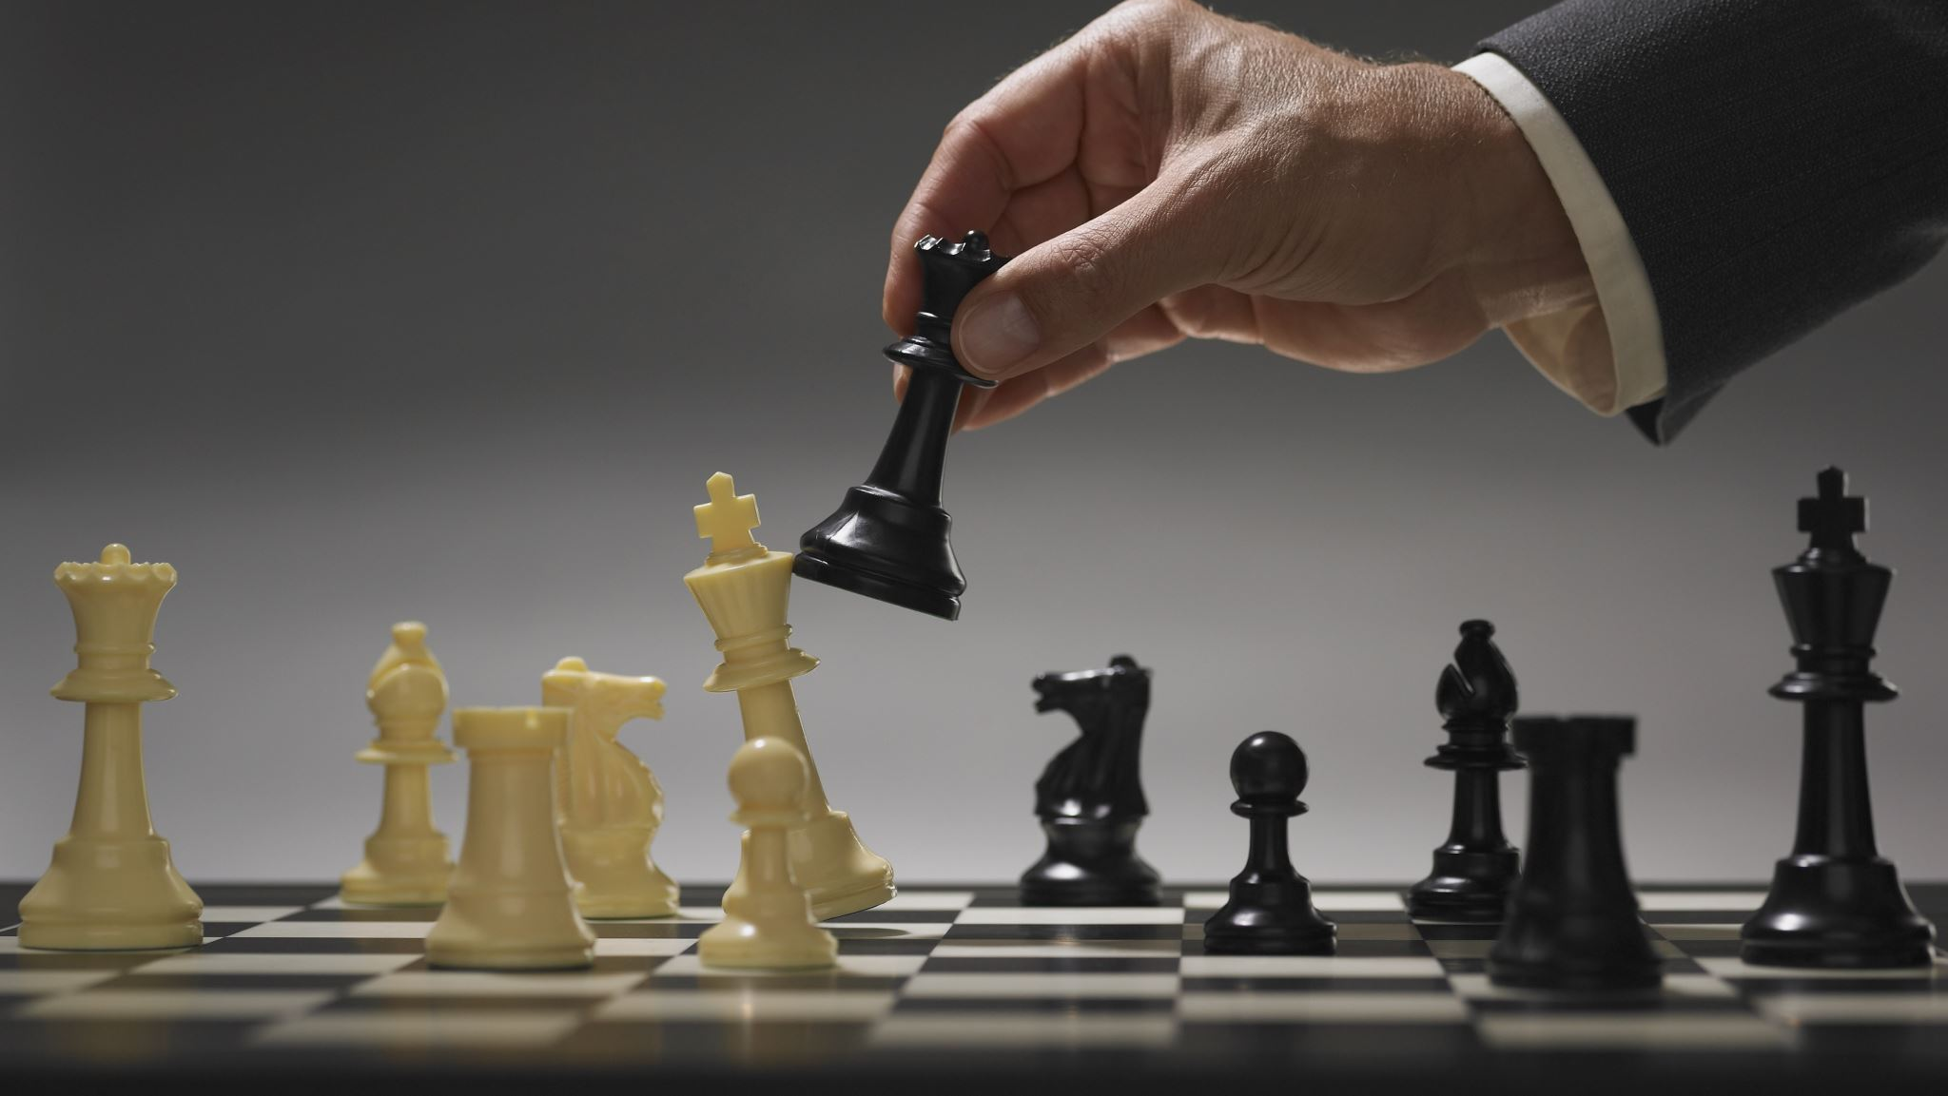
Now that computers have reached the grandmaster level and are beginning to vie for the World Championship.
Chess has proved to be too challenging for many of the AI techniques that have been thrown at it.
We wish to promote chess as the fundamental test bed recognized by our founding researchers and increase awareness of its contribution to date.

Slide 6
LITERATURE SURVEY

Slide 7

SNO | TITLE – AUTHOR PUBLICATION YEAR | PROPOSED WORK | ALGORITHM USED | ADVANTAGES | LIMITATION
1) | Application of Neurological Networks in an AI for Chess Game | The system is divided into three work : 1) Supervised learning used for moves generation 2) Unsupervised learning : Training 3) Reinforcement learning: set of data provided to the network is specific for the task of teaching the network the missing parts or the missing features. | A)Neurological network B)Reinforcement learning C)Supervised learning D)Unsupervised learning | With the more significance number of games played it was predicted that AI would win 80% of all games played. | 1)Uses a dataset to train 2)Time consuming to train
2) | Adaptive Genetic Algorithm's Implement on Evaluation Function in Computer Chinese Chess Wang Jiaol Luo Yan-hong 2005 | The system is divided into four parts: searching engine, move generator, evaluation function, opening book. Evaluation function is automatically adjusted and optimized. | A)Genetic Algorithm B) Tournament Algorithm | a)Avoid local optimum of traditional Hill-Climbing and slow convergence of Simulated-Annealing. b)AGA increases the power of our program. | a)GA is computationally expensive b)It is time consuming
3) | Genetic Algorithms for Evolving Computer Chess Programs Omid E. David, H. Jaap van den Herik 2014 | This paper demonstrates the use of genetic algorithms for evolving: 1) a grandmaster-level evaluation function, and 2) a search mechanism for a chess program | A)Genetic Algorithm | a) Improved upon by means of coevolution. b) The search mechanism is evolved by learning from tactical test suites | a)Computation and training is expensive b)Training is time taking

Slide 8
SNO | TITLE – AUTHOR PUBLICATION YEAR | PROPOSED WORK | ALGORITHM USED | ADVANTAGES | LIMITATION
4) | Candidate Moves Method Implementation in MiniMax Search Procedure of the Achilles Chess Engine 2015 | This paper presents some original improvements embedded into the basic MiniMax procedure with direct implementation in author's computer chess program Achilles. Parallel version of the Minmax procedure, based on a candidate move principle, improve basic function and increase the total playing strength of the chess engine | Candidate moves algorithm | This idea exploits the independences in game tree calculating (as shown in second Section) to accelerate the game tree calculation in distributed environment | a)Heavy computing machines are required B)Time consuming
5) | Giraffe: Using Deep Reinforcement Learning to Play Chess Matthew Lai 2015 | This report presents Giraffe, a chess engine that uses self-play to discover all its domain-specific knowledge, with minimal hand-crafted knowledge given by the programmer. | Deep reinforcement learning automatic feature extraction | a)This approach works on generality b)This approach can easily be ported to other zero-sum turn-based board games, and achieve state-of-art performance quickly | a) Time management is an important part of chess playing b) One of the major weaknesses of Giraffe is the search speed
6) | DeepChess: End-to-End Deep Neural Network for Automatic Learning in Chess Eli (Omid) David, Nathan S. Netanyahu and Lior Wolf 2016 | Present an end-to-end learning method for chess, relying on deep neural networks. | End-to-End Deep Neural Network | a)The training relies entirely on datasets of several million chess games, and no further domain specific knowledge is incorporated. | a )Takes lot of time to train b) DeepChess demonstrates the very opposite by exhibiting an adventurous playing style with frequent positional sacrifices.

Slide 9
SNO | TITLE – AUTHOR PUBLICATION YEAR | PROPOSED WORK | ALGORITHM USED | ADVANTAGES | LIMITATION
7 | Mastering Chess and Shogi by Self-Play with a General Reinforcement Learning Algorithm David Silver,1∗ Thomas Hubert 2017 | Generalise the approach into a single AlphaZero algorithm that can achieve, tabula rasa, superhuman performance in many challenging domains. | General Reinforcement Learning Algorithm | Trained solely by reinforcement learning from games of self-play So we dont need a dataset to train | Takes lots of time and many trial games to train.
8 | A general reinforcement learning algorithm that master chess, shogi and Go through self-play. David Silver, Thomas Hubert 2018 | In this paper, we generalize this approach into a single algorithm that can achieve superhuman performance in many challenging games. | Reinforcement Learning Algorithm | a)Reinforcement learning from selfplay. b) Generalize this approach into a single AlphaZero algorithm that can achieve superhuman performance in many challenging games. | Takes lots of time and many trial games to train.
9 | Playing Chess with Limited Look Ahead Arman Maesumi 2020 | We train a deep neural network to serve as a static evaluation function, which is accompanied by a relatively simple look ahead algorithm. | Deep neural network | The strength of our chess engine is assessed by comparing its proposed moves against those proposed by Stockfish. | This paper will not effect the daily lives of most people, it can certainly effect those who play chess competitively.

Slide 10
SNO | TITLE – AUTHOR PUBLICATION YEAR | PROPOSED WORK | ALGORITHM USED | ADVANTAGES | LIMITATION
10 | Chess Moves Prediction using Deep Learning Neural Networks Siddhant Mishra Hitanshu Panchal 2021 | Each board state is given as an input to the input layer of the Convolutional Neural Networks. CNN learning the game of chess and based on the result of chess is essentially pre-computation on a given situation. | A)CNN Algorithm B)Minmax Algorithm | a) Pre-computation, an evaluating function to make an evaluation on a given situation. b) Useful for training quick and moderately successful chess algorithm | a) the CNN precomputes and searches around a smaller number of positions per game b) lacks the ability to teach innovative and creative moves, and as convolution layers demonstrated, are capable at identifying small, native objectives.

Slide 11
Summary
Training needs dataset : Finding the suitable dataset to train is hard and training is expensive
Training is inefficient : For models which train with dataset , training is expensive whereas for models with reinforcement learning require many sample games or self plays which is time consuming
Computationally expensive : Models Using Genetic Algorithm are computationally expensive and need heavy computing machines

Slide 12
PROBLEM STATEMENT

Slide 13
Can a chess game with AI be designed which is more efficient in storage and time and is also convenient to play ?

Slide 14
OBJECTIVE

Slide 15
-> Designing a chess game which is efficient in time and storage and is also comfortable to use by the player.

Slide 16
SYSTEM ARCHITECTURE

Slide 17
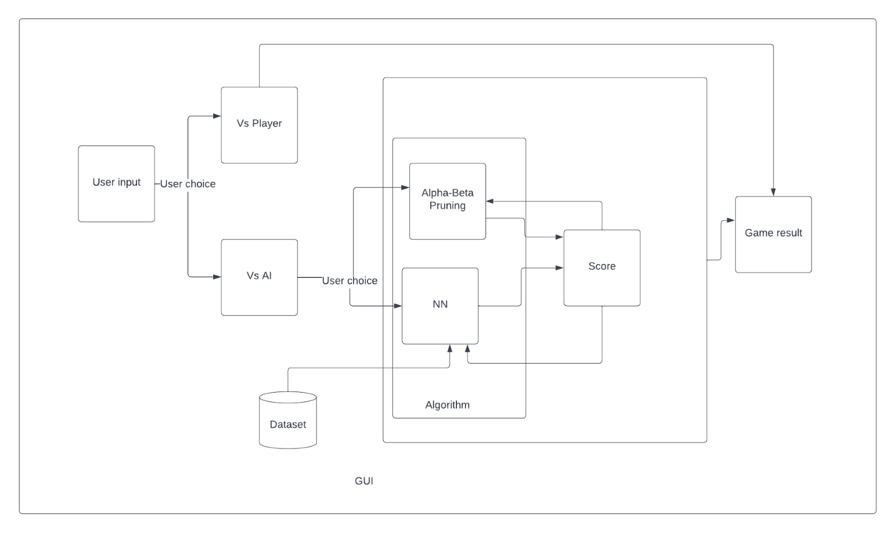

Slide 18
LIST OF MODULES

Slide 19
Module Number | Module Description
Module 1 | Human vs Human Chess game
Module 2 | Vs AI using NN Algorithm
Module 3 | Vs AI using Alpha Beta Pruning Algorithm
Module 4 | Vs Hybrid Algorithm

Slide 20
EXPLANATION OF MODULES

Slide 21
MODULE 1 Human vs Human
Functions Used:
Valid_moves - To list out the valid moves of each coin
Is_check - To check if king is under check
Search_moves - To list out the valid moves of each coin when under check
Pawn_promotion - Pawn promoting into other higher rank coins
Castling - Castling
Active_player - Player turn
Undo_moves - Player can undo a move and go back to the previous state

Slide 22
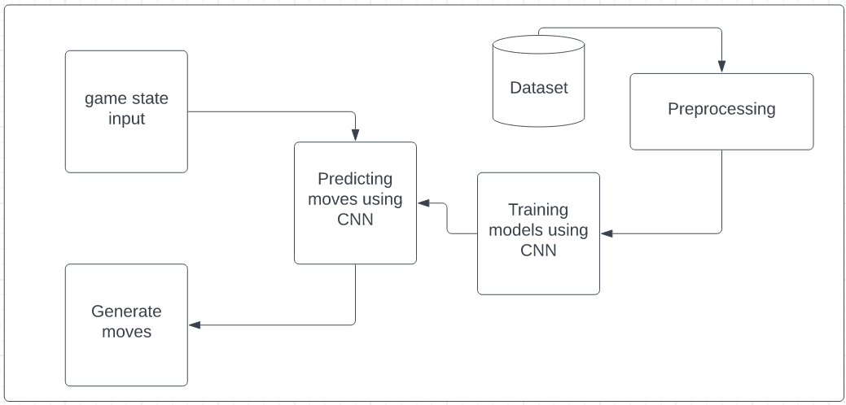
Module 2 ( vs CNN algorithm)

Slide 23
-The Convolutional neural network is the intuitive. It is trained on thousands of master chess games.
-This just means that a neural network is given a chess position , and is designed to output a move and an evaluation.

Slide 24
Steps
Preprocessing
1
Create Data
2
Transform Data
3
Creating Neural Network
4
Making Predictions
5

Slide 25
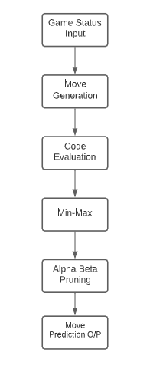
Module 3 ( vs Alpha Beta Pruning)

Slide 26
Alpha-Beta pruning is an optimization method to the minimax algorithm that allows us to disregard some branches in the search tree. This helps us evaluate the minimax search tree much deeper, while using the same resources.
The alpha-beta pruning is based on the situation where we can stop evaluating a part of the search tree if we find a move that leads to a worse situation than a previously discovered move.

Slide 27
The alpha-beta pruning does not influence the outcome of the minimax algorithm — it only makes it faster.
The alpha-beta algorithm also is more efficient if we happen to visit first those paths that lead to good moves.

Slide 28
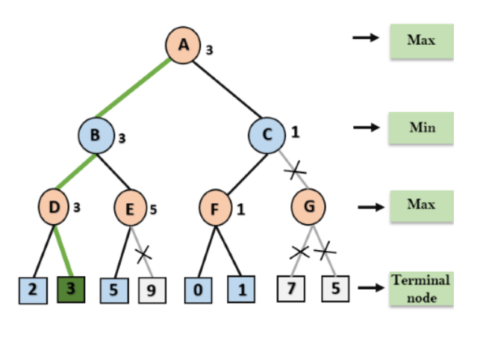
Alpha-Beta Pruning Tree

Slide 29
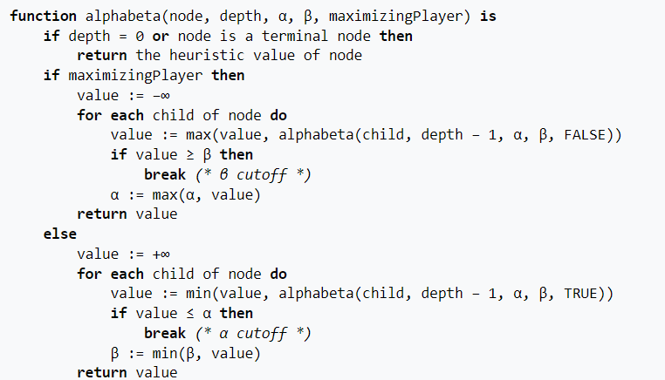
Pseudocode

Slide 30
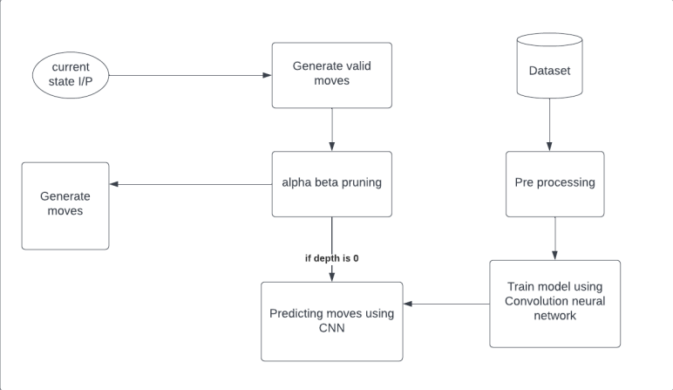
Module 4 (Vs Hybrid Algorithm)

Slide 31
The Hybrid Algorithm is a combination of the Neural Network algorithm backed up by the Alpha-Beta pruning Algorithm.
The Alpha-Beta algorithm forms a tree of depth three and the Neural Network has 2 hidden layers.

Slide 32
EVALUATION METRICS

Slide 33
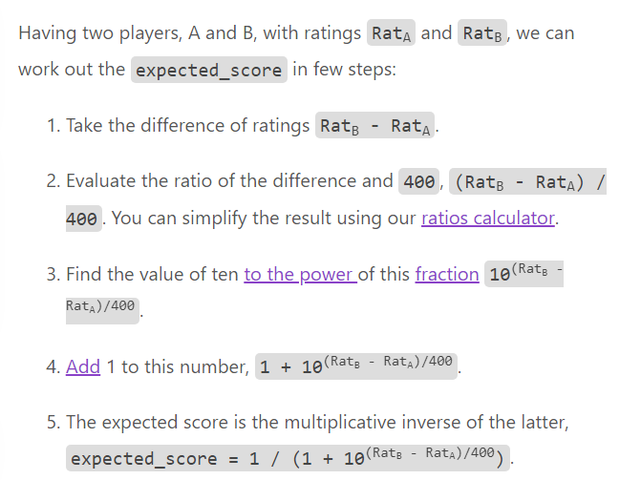
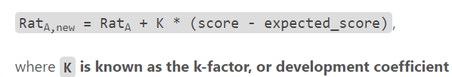
Elo rating :
The Elo rating system is a method that estimates the relative strength of a player (or team) in a game.

Slide 34
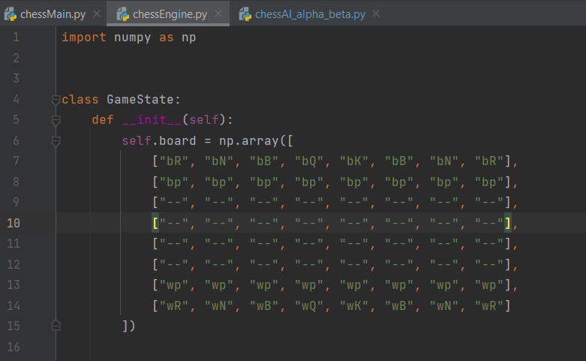
Chess AI– Implementation
Code

Slide 35
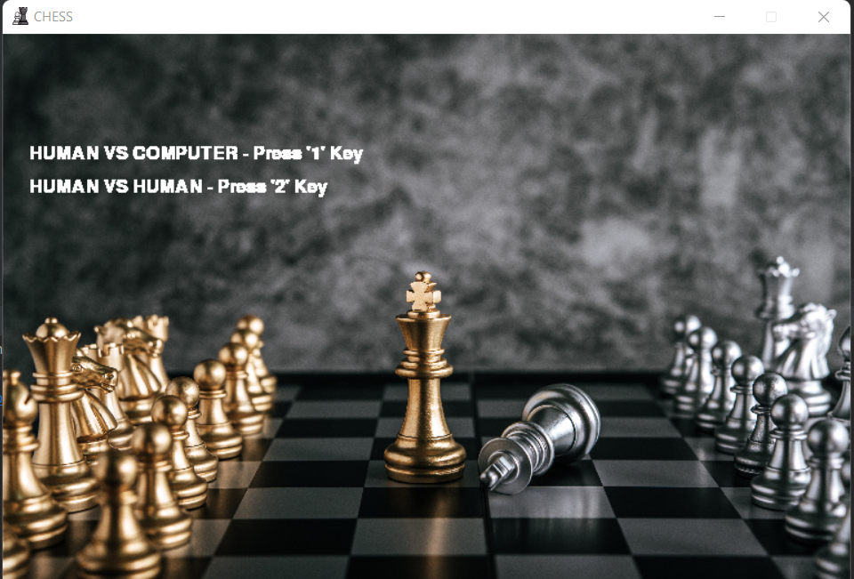
Chess AI– Screenshots
Main Page

Slide 36
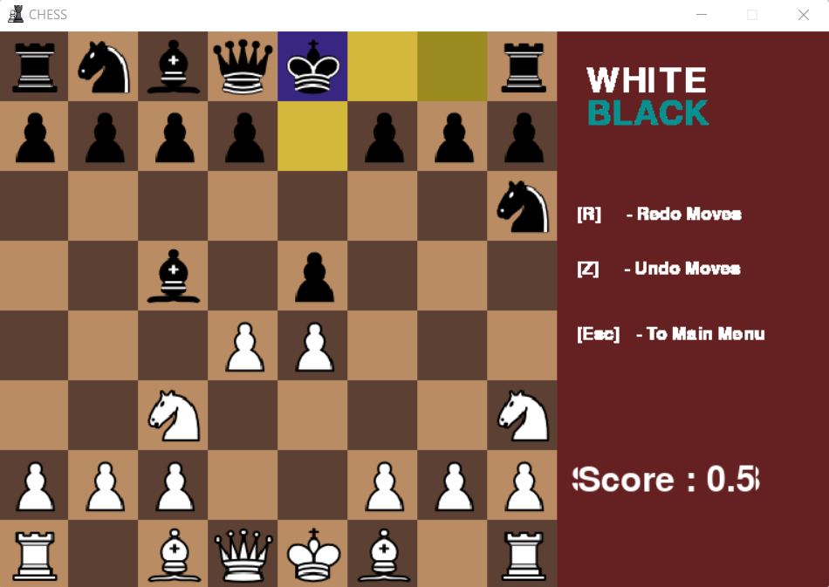
Chess AI– Screenshots
Human Vs Human Chess Game
With Player score for each player move

Slide 37
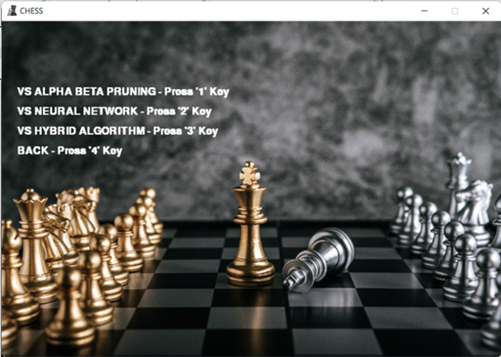
Chess AI– Screenshots
Vs AI Human vs Computer

Slide 38
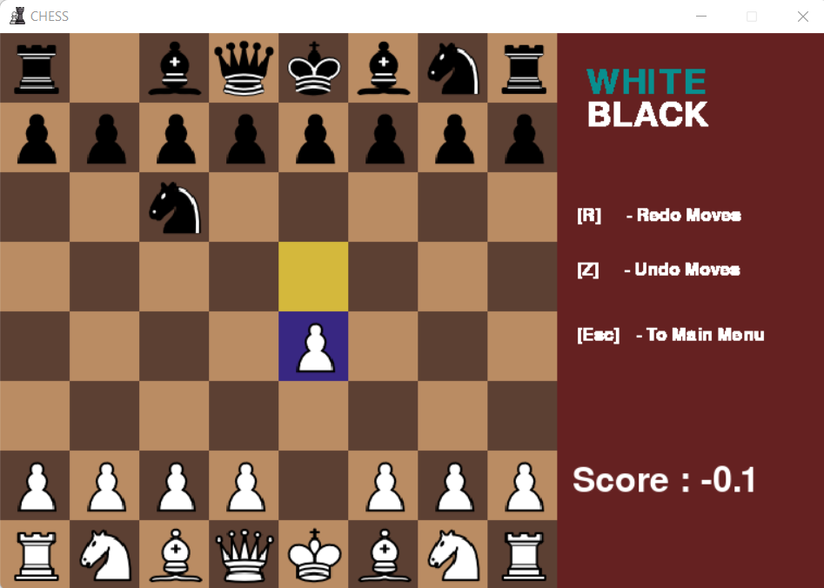
Chess AI– Screenshots
Human Vs AI Chess Game(Alpha-Beta Pruning Algorithm)
With Player score Tree of max depth 3

Slide 39
Chess AI– Screenshots
Human Vs AI Chess Game(Convolution Neural Network Algorithm)
With 2 Hidden Layers

Slide 40
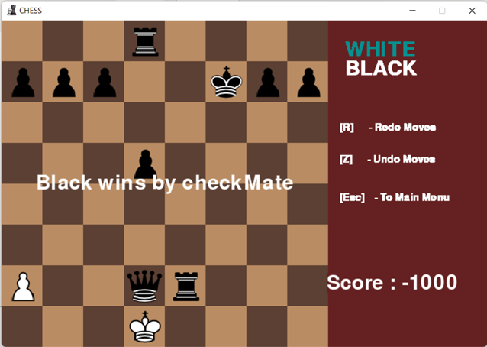
Chess AI– Screenshots
Human Vs AI Chess Game
Game Over:

Slide 41
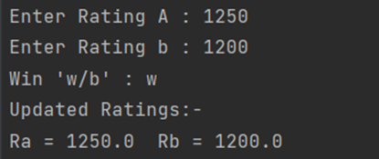
Chess AI– Screenshots
Human Vs AI Chess Game
ELO Rating Calculator

Slide 42
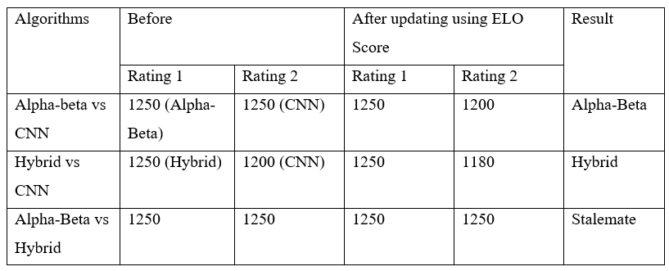
Chess AI– Screenshots
Human Vs AI Chess Game
Final ELO Rating Calculation

Slide 43
REFERENCES

Slide 44
[1] Arman Maesumi, Playing Chess with Limited Look Ahead, Technical report, Stanford University,2010
[2] David Silver and Thomas Hubert, A general reinforcement learning algorithm that master chess, shogi and Fo through self-play, Mathematical Biophysics, 5:115–137, 2018
[3] David Silver and Thomas Hubert, Mastering Chess and Shogi by Self-Play with a General Reinforcement Learning Algorithm, Journal of Evolution and Technology, 1:1–14, 2017
[4] Eli (Omid) David et all, DeepChess End to End Deep Neural Network for Automatic Learning in Chess, Foundations of Genetic Algorithms, pages 316–337. Morgan Kaufmann, San Mateo,2016

Slide 45
[5] Matthew Lai, Giraffe:Using Deep Reinforcement Learning to Play Chess, Frontiers of Evolutionary Computation, pages 1–36. Kluwer Academic Publishers, Boston,2015
[6] Omid E. David and H. Jaap van den Herik, Genetic Algorithm for Evolving Computer Chess Programs, Evolutionary Computation, 13(1):1–27,2014
[7] Siddhant Mishra Hitanshu Panchal, Chess Moves Prediction using Deep Neural Network, Connec-tionism in Perspectives, pages 173–198. North-Holland, 2021
[8] Vinay Kumar et al, Application of Neural Network in an AI for Chess Game, Amity University , Morgan Kaufman, San Mateo, Connection Science, 13:1–30,2020

Slide 46
[9] Vladan Vuckovic,Candidate Moves Method Implementation in MiniMax Search Procedure of the Achilles Chess Engine, Mind, 59:433–460, 1950, 2015
[10]Wiang Jiaol Luo Yan- hong, Adaptive Genetic Algorithm’s Implement on Evaluation in Computer Chinese Chess, Machine Intelligence 6, pages 3–23. Oxford University Press, Oxford, 2005
[11] https://github.com/victorsimrbt/chess_4096 .

